Slide 1

Java Persistence API
Notes:
1

Slide 2
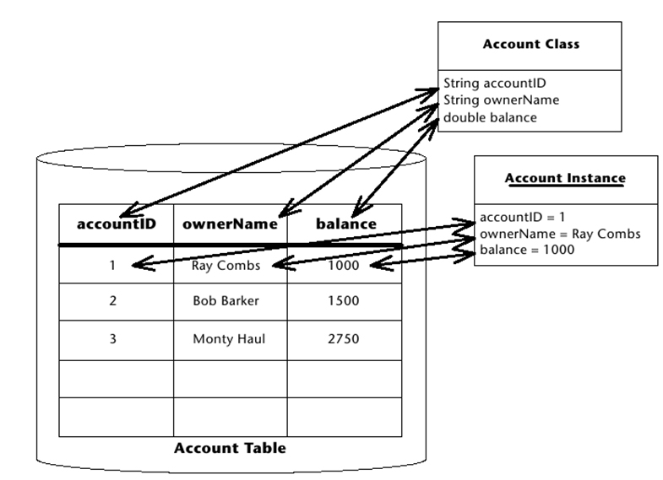
Object Relational Mapping
ORM is mapping of objects to database tables

Slide 3
Object Relational Mapping
The simplest case is to map an object to a table.
Foreign key relationships on the database side are converted to associations on the class side.
There are 3 types of foreign key relationships:
1:1 (f. e. 1 customer, 1 credit card)
1:n (f. e. 1 customer, n orders)
n:m (f. e. n orders, m products)

Slide 4
Foreign Key Relationships
1:1
Table Kunde
Table Kreditkarte
1:1 relationships are usually not split into 2 tables
A table is sufficient
Kunde
int id;
String Vorname;
String Name;
Kreditkarte karte;
Kreditkarte
int id;
long nummer;
Kunde kunde;
1
1

Slide 5
Foreign Key Relationships
1:n
Table Bestellung
Table Kunde
1:n relations are mostly expressed by 2 tables
In most cases, the primary key of one table is kept as a foreign key in the other table
BUT:
1:n relations can also be defined by a separate intermediate table

Slide 6
Foreign Key Relationships
1:n
Table Bestellung
Table Kunde
Kunde
int id;
String Vorname;
String Name;
Kreditkarte karte;
Bestellung[] bestellungen;
Bestellung
int id;
Kunde kunde;
1
n

Slide 7
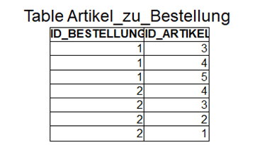
Foreign Key Relationships
m:n
Table Bestellung
Table Artikel
Artikel
int id;
String Bezeichnung;
String Modellbezeichnung;
Bestellung[] bestellungen;
Bestellung
int id;
Artikel[] artikelliste;
n
m

Slide 8
Entity Classes
An entity class is a normal Java class, commonly called POJO (Plain Old Java Object).
For each entity class, there is a mapping to one (or more) table(s) of a relational database. This mapping is declared using Java annotations.
Each entity class has a primary key that can be used to uniquely identify objects of the class.
Entity classes (unlike the earlier Entity Beans) do not require an EJB container, they can also exist in Web containers or in standalone Java applications.

Slide 9
Example of Entity Class
@Entity
public class Student {
@Id
@GeneratedValue(strategy = GenerationType.AUTO)
private Long id;
@Column(name="matnum")
private Long matrikelnummer;
public Long getId() {
return this.id;
}
public void setId(Long id) {
this.id = id;
}
public Long getMatrikelnummer() {
return matrikelnummer;
}
public void setMatrikelnummer(Long matrikelnummer) {
this.matrikelnummer = matrikelnummer;
}
}

Slide 10
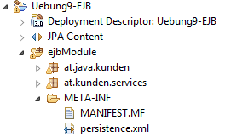
Configuration of Database Connection
The database connection is configured in Java EE in the application server and gets a name there.
In the application you have to define the configuration in META-INF/persistence.xml.

Slide 11
Example of persistence.xml
<?xml version="1.0" encoding="UTF-8"?>
<persistence ...>
<persistence-unit name="myPU" transaction-type="JTA">
<provider>org.hibernate.ejb.HibernatePersistence</provider>
<jta-data-source>java:datasources/kundendb</jta-data-source>
<exclude-unlisted-classes>false</exclude-unlisted-classes>
<properties>
<property name="hibernate.hbm2ddl.auto" value="update" />
</properties>
</persistence-unit>
</persistence>

Slide 12
Entity Manager
The Entity Manager is the instance that controls the lifecycle of entity classes.
It instances entity objects via database queries
It synchronizes entity objects with the database

Slide 13
Entity Manager in Java SE
public class MyClass {
public class myMethod() {
EntityManagerFactory emf = Persistence.createEntityManagerFactory("myPU");
EntityManager em = emf.createEntityManager();
em.getTransaction().begin();
em.persist(new MyEntity());
em.getTransaction().commit();
em.close();
emf.close();
}
}

Slide 14
Entity Manager in Java EE
public class MyClass {
@PersistenceContext(unitName="myPU") EntityManager em;
public void myMethod() {
em.persist(new MyEntity());
}
}

Slide 15
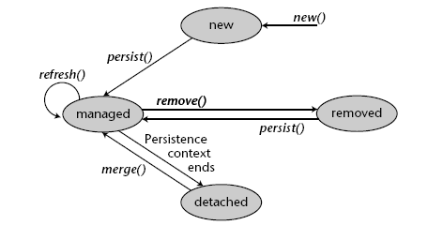
Lifecycle of Entity Object

Slide 16
Lifecycle of Entity Object
New: The object was created using the new operator in the Java Virtual Machine (JVM). The object does not yet have an equivalent in the relational database, it is not managed by the Entity Manager yet.
Managed: The object is managed by the Entity Manager. Entity Manager knows if attributes of an object have changed. It decides when changed attributes are written to the database and when the object is read anew from the database. Writing to the database and refreshing can also be forced programmatically.
Removed: The object still exists in the JVM, it is managed by the Entity Manager, but it is marked for deletion in the database.
Detached: The object exists in the database and in the JVM, but it is no longer managed by the Entity Manager (occurs when the object is transported between JVMs or the transaction is terminated).

Slide 17
Methods of Entity Manager
persist(): An object with state new is placed under the management of the Entity Manager (managed) and written to the database
refresh(): An object with state managed is read again from the database
remove(): An object with state managed is marked for deletion and deleted from the database upon completion of the transaction. The Java object persists.
merge(): An object that is not under the management of the Entity Manager, but is already stored in the database, is placed under management of the Entity Manager. The data of the object are written into the database at the end of the transaction.
flush(): All changes in the object are written to the database
find(): The object with the specified primary key is fetched from the database.
createQuery("select ..."): A custom database query is defined, query.getResultList() is used to read the result in form of Java objects.

Slide 18
Methods of Entity Manager
@Stateless
@WebService
public class StudentService {
@PersistenceContext
EntityManager em;
public Student getStudentByID(Long id) {
return em.find(Student.class, id);
}
public List<Jahrgang> getAllJahrgaenge(){
return em.createNamedQuery("findAllJahrgaenge",
Jahrgang.class)
.getResultList();
}
}

Slide 19
Methods of Entity Manager
@Stateless
@WebService
public class StudentService {
@PersistenceContext
EntityManager em;
public void createSomeTestData(){
Adresse adresse = new Adresse();
Jahrgang jahrgang = new Jahrgang();
jahrgang.setJahr(2004);
em.persist(jahrgang);
adresse.setStrasse("Thomas Edison Straße");
adresse.setHausnummer("2");
adresse.setOrt("Eisenstadt");
adresse.setPlz("7000");
em.persist(adresse);
Student student = new Student();
student.setVorname("Peter");
student.setNachname("Wind");
student.setMatrikelnummer(123456L);
student.setEmail("peter.wind@abc.com");
student.setAdresse(adresse);
student.setJahrgang(jahrgang);
em.persist(student);
}
}

Slide 20
Lifecycle Callback Methods
As with Session Beans, callback methods are annotated:
@PrePersist, @PostPersist
@PreRemove, @PostRemove
@PreUpdate, @PostUpdate
@PostLoad

Slide 21
Definition of Mapping
The mapping of objects to the database is done via annotation:
@Entity ... defines the class as entity class; by default, table name = class name is assumed
@Id ... defines an attribute as the primary key of the entity class
@GeneratedValue (strategy = GenerationType.AUTO) ... tells the Persistence Manager that the primary key of the entity class should be generated automatically
@Column ... defines an attribute to be persisted; by default, attribute name = column name is assumed

Slide 22
Definition of Mapping
@Entity
public class Student {
@Id
@GeneratedValue(strategy = GenerationType.AUTO)
private Long id;
@Column(name="matnum")
private Long matrikelnummer;
public Long getId() {
return this.id;
}
public void setId(Long id) {
this.id = id;
}
public Long getMatrikelnummer() {
return matrikelnummer;
}
public void setMatrikelnummer(Long matrikelnummer) {
this.matrikelnummer = matrikelnummer;
}
}

Slide 23
Foreign Key Relationships
When defining foreign key relationships, it must always be considered on which side of the two tables the foreign key is located (see next slide):
1:n
Table Bestellung
Table Kunde

Slide 24
Foreign Key Relationships
The most important annotations for the definition of foreign key relationships are:
@JoinColumn ... defines an attribute as foreign key
@OneToOne ... defines 1:1 relationship
@OneToMany or @ManyToOne ... defines 1:n relationship
@ManyToMany ... defines m:n relationship

Slide 25
Foreign Key Relationships
1:1
Table Kunde
Table Kreditkarte
1:1 relationships are usually not split into 2 tables
A table is sufficient
Kunde
@Id int id;
String Vorname;
String Name;
@OneToOne
@JoinColumn(name = "ID_KARTE")
Kreditkarte karte;
Kreditkarte
@Id int id;
Long nummer;
@OneToOne(mappedBy="karte")
Kunde kunde;
1
1

Slide 26
Foreign Key Relationships
1:n
Table Bestellung
Table Kunde
Kunde
@Id int id;
String Vorname;
String Name;
@OneToMany(mappedBy="kunde")
Collection<Bestellung> bestellungen;
Bestellung
@Id int id;
@ManyToOne
@JoinColumn(name="ID_KUNDE")
Kunde kunde;
1
n

Slide 27
Foreign Key Relationships
m:n
Table Bestellung
Table Artikel
Bestellung
@Id int id;
@ManyToMany
@JoinTable(name="ARTIKEL_ZU_BESTELLUNG",
joinColumns={@JoinColumn(name="ID_BESTELLUNG")},
inverseJoinColumns={@JoinColumn(name="ID_ARTIKEL")})
Collection<Artikel> artikel;
n
m
Artikel
@int id;
String Bezeichnung;
String Modellbezeichnung;
@ManyToMany(mappedBy="artikel")
Collection <Bestellung> bestellungen;

Slide 28
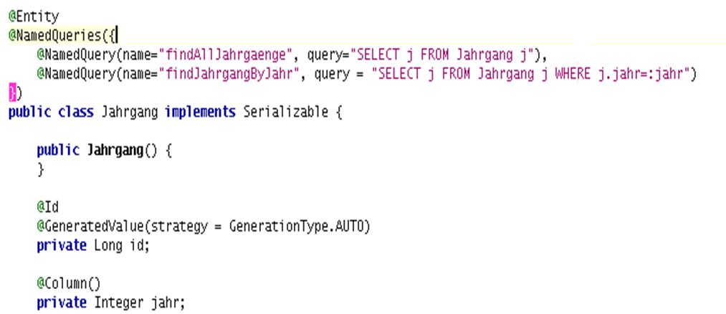
JP Query Language
Definition of queries takes place in the entity class:

Slide 29
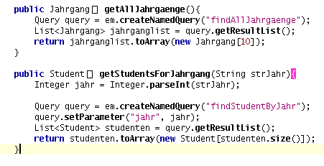
JP Query Language
Executing queries:

Slide 30
JP Query Language
SELECT s FROM Student AS s
is the same as
SELECT s FROM Student s
... fetches all entries of table
Executing a named query:
List<Student> studenten= em .createNamedQuery("findAllStudenten", Student.class) .getResultList();
Executing a dynamic query:
List<Student> studenten= em .createQuery("SELECT s FROM Student s", Student.class) .getResultList();
If you want to read only one value:
...getSingleResult();

Slide 31
JP Query Language
Setting parameters:
List<Student> studenten = em
.createQuery("SELECT s FROM Student s " +
"WHERE s.alter >= :minalter AND s.alter <= :maxalter",
Student.class) .setParameter("minalter", 17) .setParameter("maxalter",46) .getResultList();
Reading out individual columns:
List<Object[]> result = em .createQuery("SELECT s.vorname, s.nachname " +
"FROM STUDENT s")
.getResultList();
for (Object[] row: result){
String vorname = (String) row[0];
String nachname = (String) row[1];
}

Slide 32
JP Query Language
Navigating through objects:
SELECT s.jahrgang.jahr FROM Student s
DISTINCT:
SELECT DISTINCT s.vorname FROM Student s
NULL:
SELECT s FROM Student s WHERE s.vorname IS NULL
Joins:
SELECT s.name, l.name FROM Student s LEFT JOIN s.lehrer l

Slide 33
JP Query Language
Joins in SQL:
SELECT A.EineSpalte, B.EineAndereSpalte
FROM Table1 AS A JOIN Table2 AS B
ON A.EinWert = B.EinAndererWert
Joins in JPQL:
SELECT s.name, l.name FROM Student s LEFT JOIN s.lehrer l
Sorting:
SELECT s FROM Student s ORDER BY s.name DESC
SELECT s FROM Student s ORDER BY s.name ASC

Slide 34
Transactions
Optimistic transactions
Every row in a database table gets a version number. The logic runs like this:
Client1 reads a record with the version number <1>
Client2 reads the same record with the version number <1>
Client2 wants to write the record. The Entity Manager compares the version of the record, which Client2 (<1>) wants to write, with the version in the database (also <1>)
The version numbers are the same, so the Entity Manager writes the record, increasing the version number of the record to <2>
Client1 wants to write the record. The Entity Manager compares the version numbers of the record, which Client1 (<1>) wants to write, with that in the database (version <2>)
The Entity Manager throws an exception because it recognizes that the record was changed by another client.

Slide 35
Transactions
Pessimistic transactions
As soon as a client fetches a record for processing, the corresponding record is blocked:
Client1 reads the record and simultaneously locks it for editing → OK
Client2 reads the data set → OK
Client2 tries to read the record again and lock it at the same time. The Entity Manager throws an exception.
Client1 writes the record and releases it again.

Slide 36
Transactions
Implementing optimistic transaction logic
The entity class gets an attribute that carries the version number. This attribute is marked with the @Version annotation.
@Version private Long version;
public Long getVersion() {return version;}
public void setVersion(Long version) {this.version = version;}
The Entity Manager throws an OptimisticLockException in case of conflict.
How does the Entity Manager do it?
UPDATE student set vorname="Michael", version = version + 1 WHERE id = 12 AND version = 101;
The Entity Manager gets the number of changed rows from the database. If its equals 0 then there is a conflict.

Slide 37
Transactions
Implementing pessimistic transaction logic
Calling the lock() method locks the recording regarding concurrent write access. While a transaction has locked a record, no other transaction can write.
em.lock(student, LockModeType.WRITE);

Slide 38
Cascading
Cascading means that a database operation is also performed on the associated objects of an entity object.
Example: A student object is newly created in the JVM, an address object is newly created in the JVM. The address object is attached to the student. Then the method persist() is called for the student object, whereupon the student as well as the address are created in the database at the same time.
After that, the student is deleted from the database, whereby the address is deleted too.
Cascading can be set by using the annotations @OneToMany, @ManyToOne, @OneToOne, and @ManyToMany.
@ManyToMany(cascade = CascadeType.ALL)
@OneToOne(cascade = {CascadeType.PERSIST, CascadeType.MERGE})
@OneToMany(cascade = CascadeType.DELETE)
The following options exist: ALL, PERSIST, MERGE, REMOVE, REFRESH

Slide 39
Constraints
Constraints, i. e. mandatory conditions, can be partially solved by cascading.
On the other hand, constraints can be set on attributes:
@Column(nullable=false, unique=true)
It can be controlled whether attributes can be written:
@Column(insertable=false, updatable=false)
These attributes can also be set for @JoinColumn.

Slide 40
Lazy Loading
Lazy Loading can be used to control whether associated objects should be loaded immediately from the database, or only when accessed.
@OneToMany(fetch=FetchType.EAGER)
... the associated objects are loaded immediately (in worst case, this can be the whole database!)
@ManyToMany(fetch=FetchType.LAZY)
... the Entity Manager is suggested to load the attributes only when they are accessed. This results in an exception if the entity object is no longer managed!

